Slide 1
Knox County Schools Balanced Calendar Discussion
Excellence for Every Child

Slide 2
KCS FIVE-YEAR STRATEGIC PLAN GOAL 1: FOCUS ON EVERY STUDENT
Objective 2, Initiative 3a:
“We will examine, with considerable input from our stakeholders, how the school schedule and academic calendar may be used to maximize learning. We will explore the feasibility of transitioning from a traditional school calendar to a “Balanced Calendar,” which can provide students more immediate intervention and enrichment opportunities.”

Slide 3
COMMUNITY ENGAGEMENT PROCESS
Preliminary discussion with the Knox County Board of Education – November 2014. Recommendations:
Full discussion with the community
Narrow the balanced calendar choices
Identify potential costs associated with a balanced calendar
Notes:
A balanced calendar is not a new concept. In fact, many schools and districts have been implementing a balanced calendar for decades. Simply put, a balanced calendar modifies the traditional school calendar to redistribute and reallocate instructional days in a way that reduces the long summer break and provides for more continuous learning with breaks throughout the year. The following slides will illustrate this concept.

Slide 4
COMMUNITY ENGAGEMENT PROCESS
Balanced Calendar Webpage/Email Link – November 2014
DAC Discussion/Survey Pilot – Winter 2014-2015
School Community Meetings – February/March 2015
Community Daycare Meetings – April 2015
Community Survey – April/May 2015

Slide 5
FEEDBACK FROM SCHOOL COMMUNITY MEETINGS: PROS (most frequent responses)

Slide 6
FEEDBACK FROM SCHOOL COMMUNITY MEETINGS: CONS (most frequent responses)

Slide 7
FEEDBACK FROM SCHOOL COMMUNITY MEETINGS: CONCERNS (most frequent responses)

Slide 8
COMMUNITY DAYCARE MEETINGS
Concerns:
Change in schedule
Potential lack of available employees (college students)
Impact of change on teachers’ children (potential financial impact)
Access to KCS facilities during breaks
Alignment with other contiguous school districts not utilizing a balanced calendar
Potential negative impact on preschool age children
Need for adequate advance notice
What about Community School programs?

Slide 9
COMMUNITY SURVEY RESULTS

Slide 10
COMMUNITY SURVEY RESULTS: ALL

Slide 11
COMMUNITY SURVEY RESULTS: ALL

Slide 12
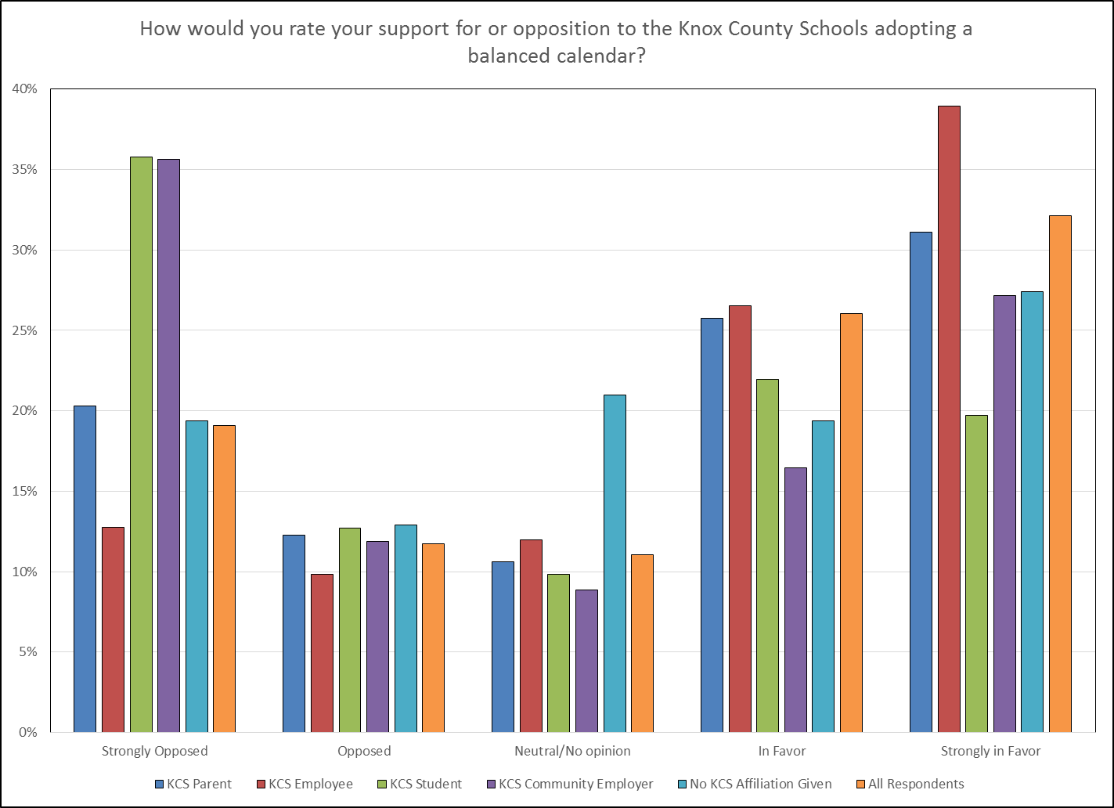
COMMUNITY SURVEY RESULTS: ALL

Slide 13
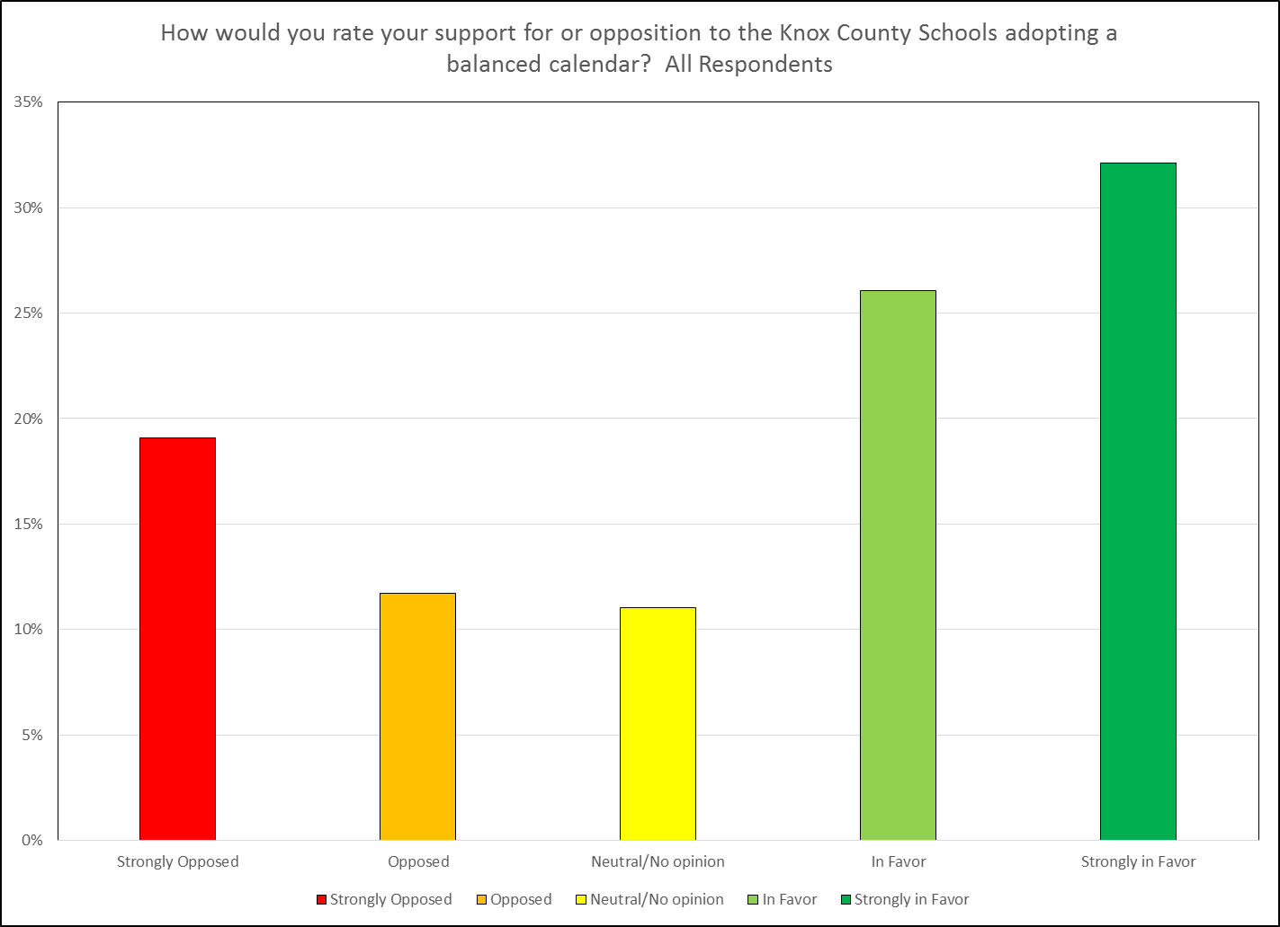
COMMUNITY SURVEY RESULTS: ALL

Slide 14
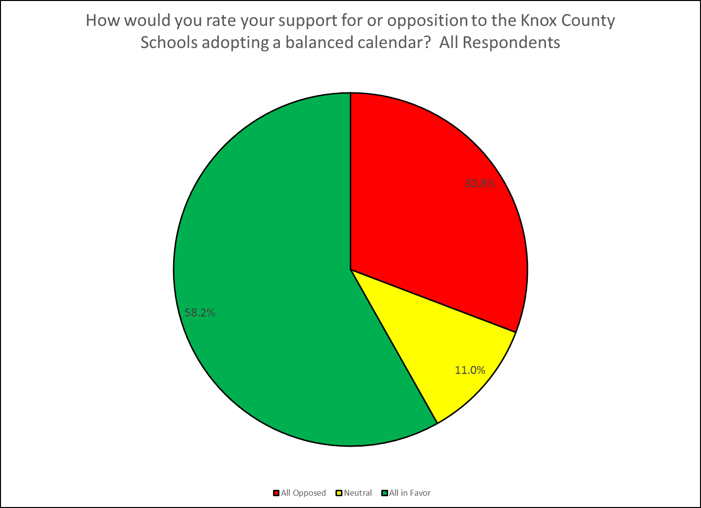
COMMUNITY SURVEY RESULTS: ALL

Slide 15
COMMUNITY SURVEY RESULTS: ALL

Slide 16
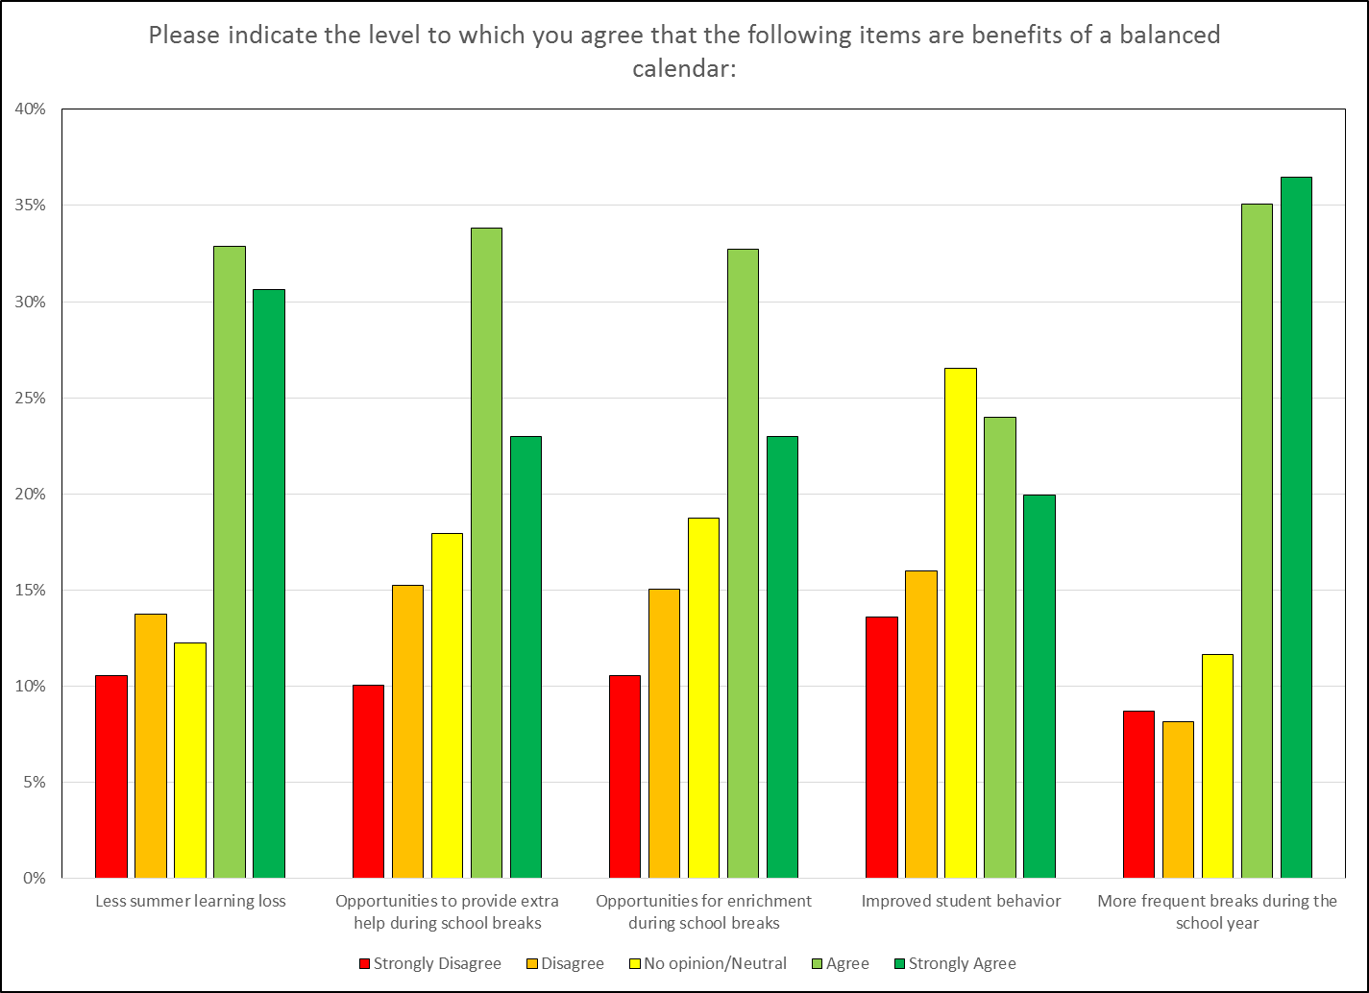
POTENTIAL BENEFITS: ALL

Slide 17
COMMUNITY SURVEY RESULTS: ALL

Slide 18
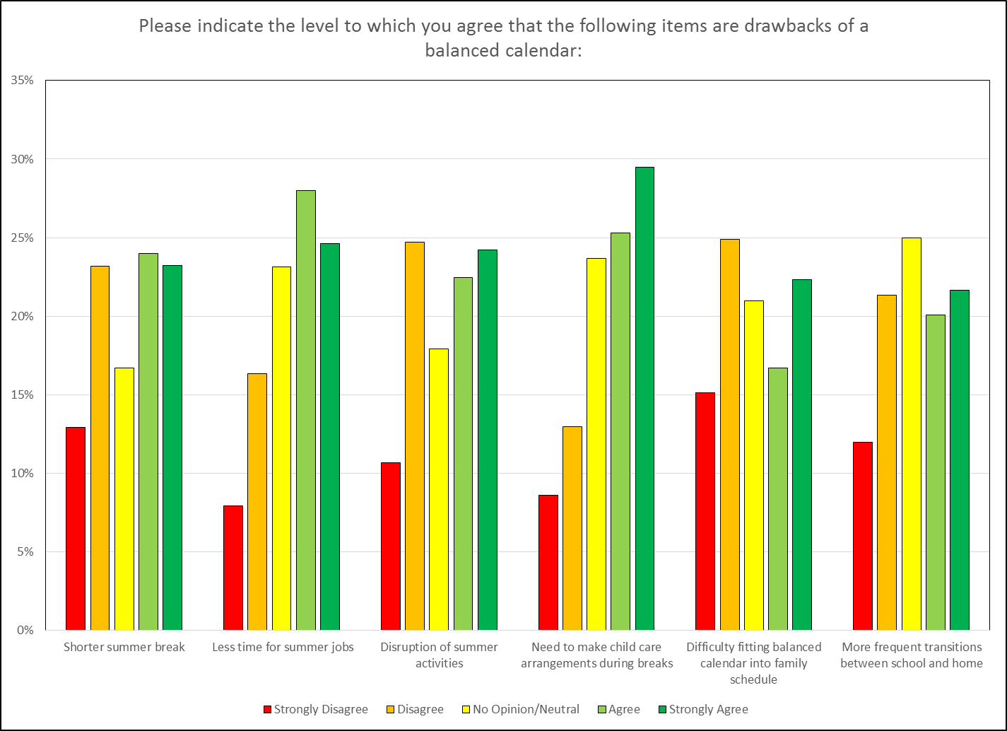
POTENTIAL DRAWBACKS: ALL

Slide 19
TEACHER SURVEY RESULTS

Slide 20
PARENT SURVEY RESULTS

Slide 21
PARENT SURVEY RESULTS

Slide 22
PARENT SURVEY RESULTS

Slide 23
STUDENT SURVEY RESULTS

Slide 24
STUDENT SURVEY RESULTS

Slide 25
EMPLOYER SURVEY RESULTS

Slide 26
EMPLOYER SURVEY RESULTS

Slide 27
PROPOSED CALENDAR MODELS: 2016-2017
Draft traditional model
Draft traditional model with one-week fall break
Draft balanced calendar model (45/10 model)

